Slide 1
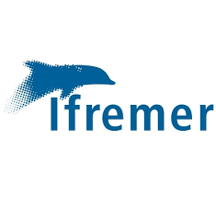
Collecting data for the future of oceanographic and fisheries science in the EU outermost regions
Sylvain Bonhommeau – Délégation de l’Océan Indien
Contact: sylvain.bonhommeau@ifremer.fr

Slide 2
1st Meeting of the Outermost Regions Forum for Maritime Affairs and Fisheries
Outline
1- Status of fish stock and knowledge about oceanographic environment in the outermost regions
2- From modeling to data: collecting the relevant data to feed models
3- An open data network to inform sound managements

Slide 3
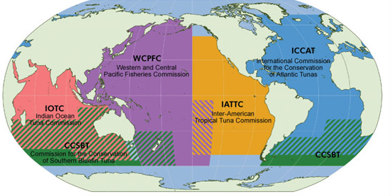
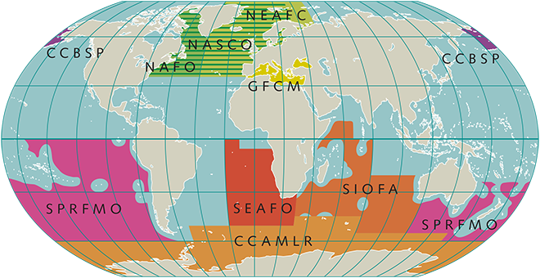
1- Status of fish stock and knowledge about oceanographic environment in the outermost regions
Regional Fisheries Management Organization
For large pelagics
For demersal fish
1st Meeting of the Outermost Regions Forum for Maritime Affairs and Fisheries - June 26 2018

Slide 4
1- Status of fish stock and knowledge about oceanographic environment in the outermost regions
Species | ICCAT | IOTC
Albacore
Bigeye tuna
Yellowfin tuna
Skipjack tuna
Bluefin tuna
Swordfish*
Marlins *
Sailfish
Neretics | No assessments
Sharks | Depends | Under progress
Ecosystem** |  | Under progress
Color | Meaning
 | Not overfishing Nor overfished
 | Overfishing Or overfished
 | Mostly overfishing and overfished
 | Overfishing and overfished
* | Several stocks or species
1st Meeting of the Outermost Regions Forum for Maritime Affairs and Fisheries - June 26 2018

Slide 5
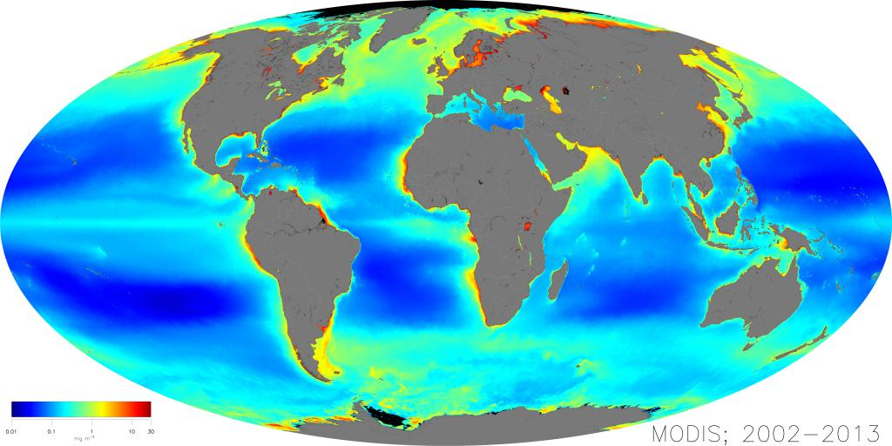
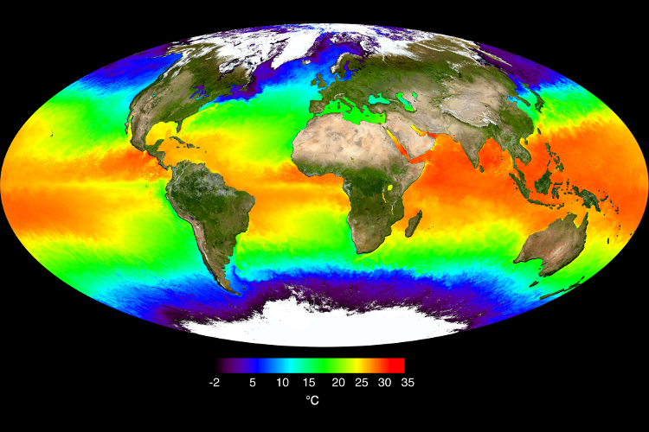
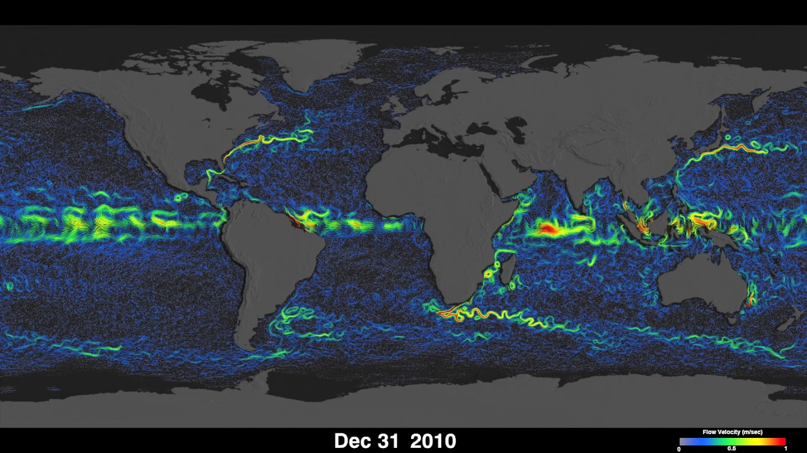
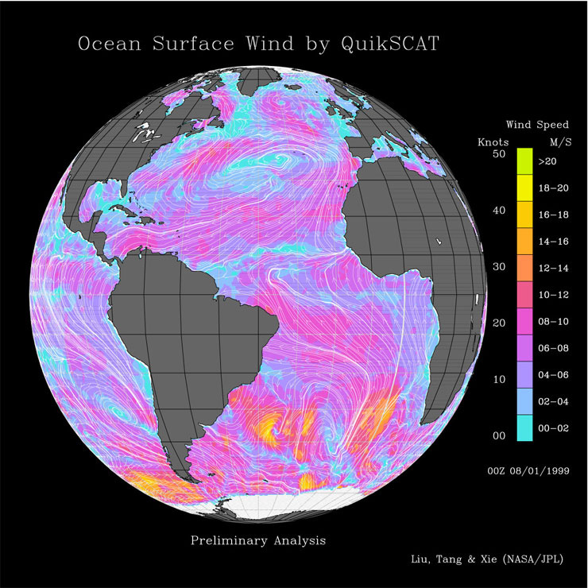
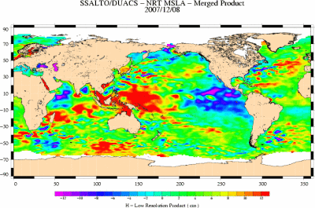
1- Status of fish stock and knowledge about oceanographic environment in the outermost regions
Chlorophyll
Temperature
Currents
Sea level anomaly
Wind
1st Meeting of the Outermost Regions Forum for Maritime Affairs and Fisheries - June 26 2018

Slide 6
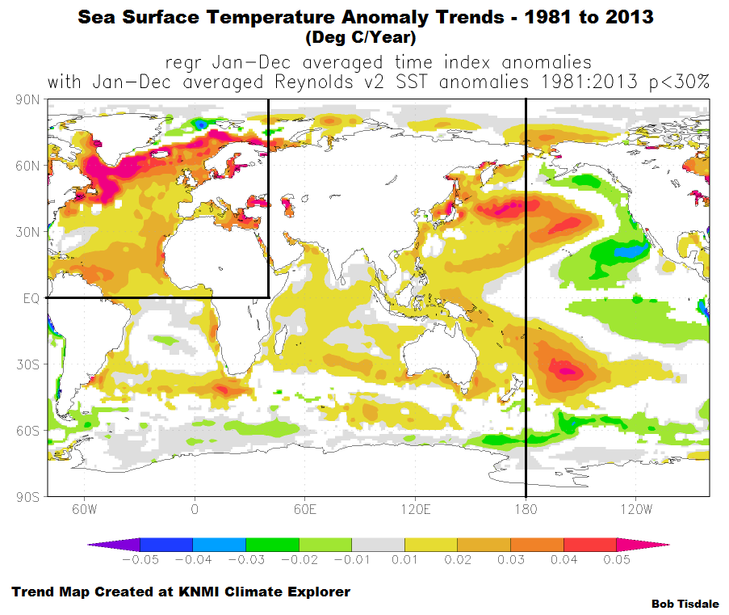
1- Status of fish stock and knowledge about oceanographic environment in the outermost regions
1st Meeting of the Outermost Regions Forum for Maritime Affairs and Fisheries - June 26 2018

Slide 7
2- From modeling to data: collecting the relevant data to feed models
Data collection
Models
Management
1st Meeting of the Outermost Regions Forum for Maritime Affairs and Fisheries - June 26 2018

Slide 8
2- From modeling to data: collecting the relevant data to feed models
Data collection
Definition of
needs
Models
Definition of
needs
Management
1st Meeting of the Outermost Regions Forum for Maritime Affairs and Fisheries - June 26 2018

Slide 9
2- From modeling to data: collecting the relevant data to feed models
Data collection
Needs
Measured variables
Levels of accuracy, frequency, ...
Areas
Definition of
needs
Models
Means
Scientific data collection
Private sector data collection
Citizen science (e.g. IoT)
Definition of
needs
Management
1st Meeting of the Outermost Regions Forum for Maritime Affairs and Fisheries - June 26 2018

Slide 10
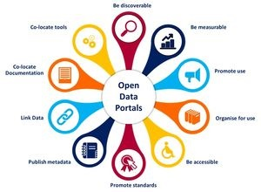
3- An open data network to inform sound managements
Common standard for data (exists for oceanography but not fisheries)
Freely accessible
Enlarge data management plans
Not remote if regions are connected! Work with and help third countries to collect and share data
Provide common and open services (Virtual Research Environment; eg. H2020 Bluebridge)
Develop big data tools
1st Meeting of the Outermost Regions Forum for Maritime Affairs and Fisheries - June 26 2018

Slide 11
Take-home message
Fisheries
Fisheries
Recommandations
Weaknesses
Recommandations
Strengths
Weaknesses
Strengths
Strong efforts in tuna RFMOs with success (bluefin tuna)
EU data collection through the European Maritime and Fisheries Fund (77)
Strong efforts in tuna RFMOs with success (bluefin tuna)
EU data collection through the European Maritime and Fisheries Fund (77)
Starting efforts in demersal RFMOs (e.g. SOFIA)
Little knowledge and data for sharks, billfish and neretic species
Ecosystem approach needed
Improve scientific knowledge on marine species
Cooperate with third countries to collect more fisheries data
Manage fisheries!
Starting efforts in demersal RFMOs (e.g. SOFIA)
Little knowledge and data for sharks, billfish and neretic species
Ecosystem approach needed
Very sensitive to global change
Improve scientific knowledge on marine species
Cooperate with third countries to collect more fisheries data
Manage fisheries!
1st Meeting of the Outermost Regions Forum for Maritime Affairs and Fisheries - June 26 2018

Slide 12
Take-home message
Fisheries
Oceanography
Recommandations
Weaknesses
Recommandations
Strengths
Weaknesses
Strengths
Strong efforts in tuna RFMOs with success (bluefin tuna)
EU data collection through the European Maritime and Fisheries Fund (77)
Global data
Coastal EU data through the Water Directive Framework
Starting efforts in demersal RFMOs (e.g. SOFIA)
Little knowledge and data for sharks, billfish and neretic species
Ecosystem approach needed
Improve scientific knowledge on marine species
Cooperate with third countries to collect more fisheries data
Manage fisheries!
Regional and fine scale data and model
Marine Framework Strategy Directive not applied in outermost regions
Low maritime traffic while well located
Develop regional models and collect more oceanic data
Cooperate with third countries to share efforts
More interactions needed between research fields (physics, biology, ecology, economy, ...)
1st Meeting of the Outermost Regions Forum for Maritime Affairs and Fisheries - June 26 2018

