Slide 1
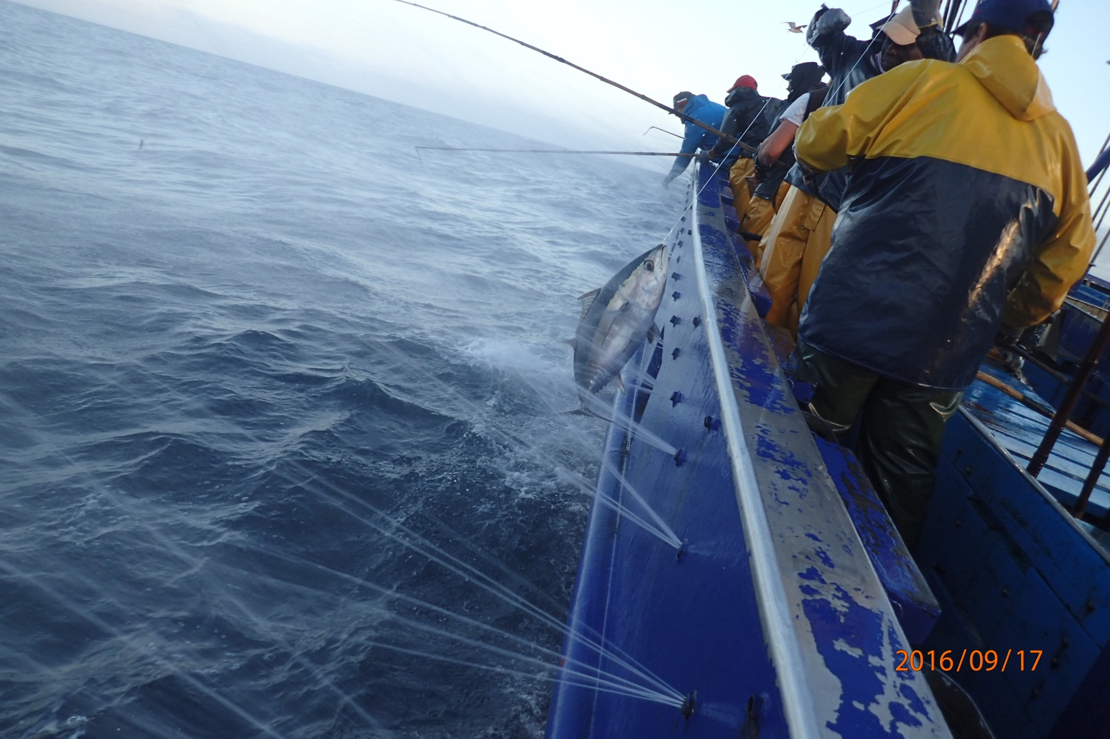
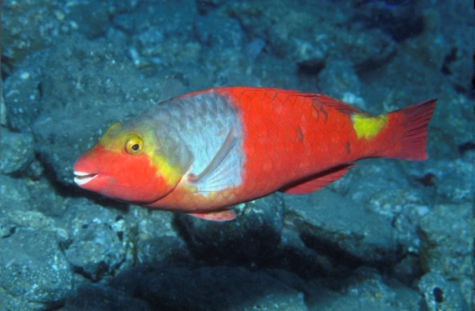
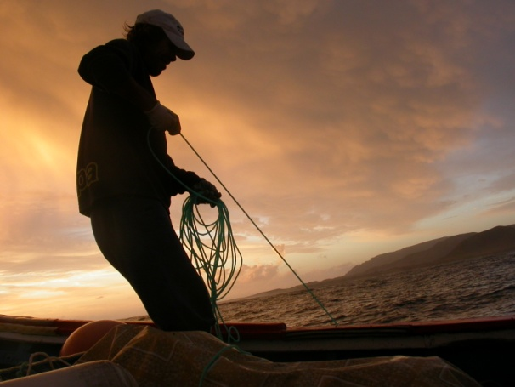
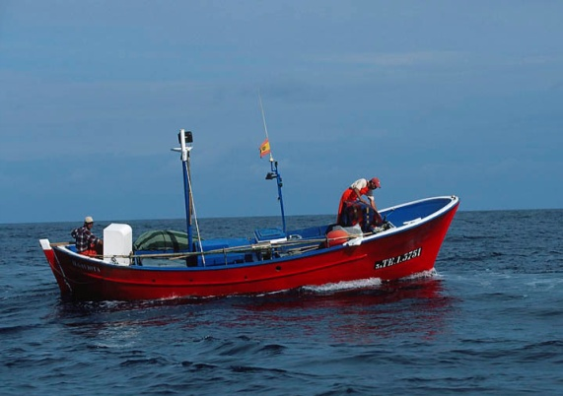
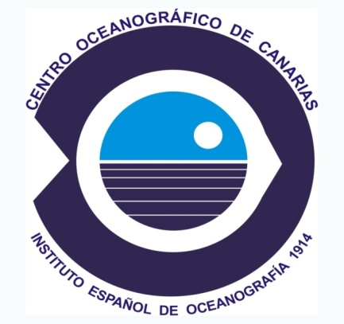
Applying the Data Collection Framework (DCF) to fisheries systems in the ORs: state of play and challenges in the Canary Islands
Catalina Perales-Raya
1st Meeting of the Outermost Regions Forum
for Maritime Affairs and Fisheries
Brussels, 26 June 2018

Slide 2
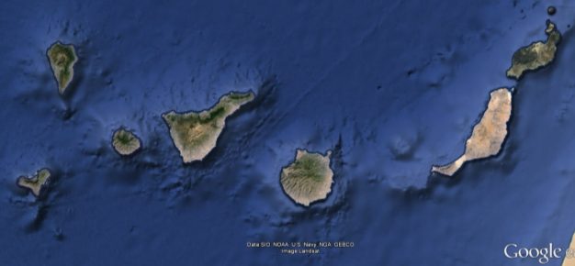
The Canary Islands: ecosystem and SSF
Location: approx.100km off African coast (29°-27°N, 19°-13°W). Seven volcanic islands: narrow insular shelf. EU waters in CE Atlantic - Africa
Oceanic waters transported by Canary Current: oligotrophic and influenced by African upwelling
Soft east-west gradient of increasing Tª & Salinity
Variety of marine resources (warm, subtropical and tropical species): tuna, small pelagics, demersal fish and invertebrates
Fleet: POLYVALENT and MULTISPECIFIC. Most of vessels under “minor-gear” licences conducting daily trips
Africa
IEO: monitoring the SSFs through EU-Data Collection Framework
Canary/Spanish Fishery Offices: first-sale notes for official statistics of landings and effort

Slide 3
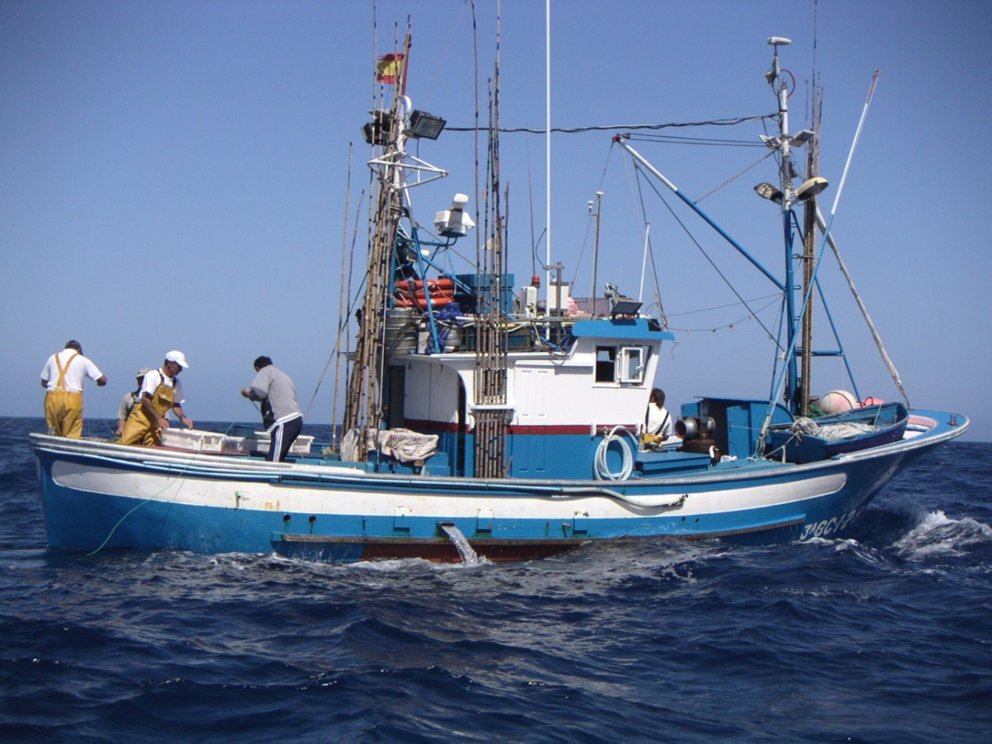
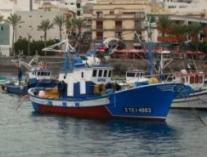
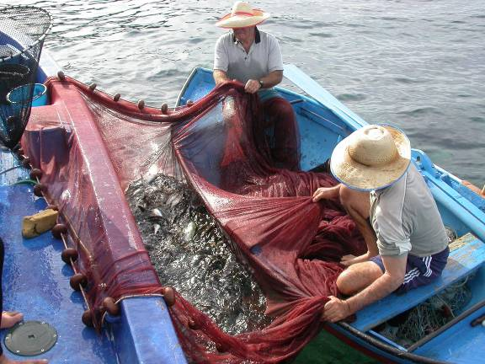
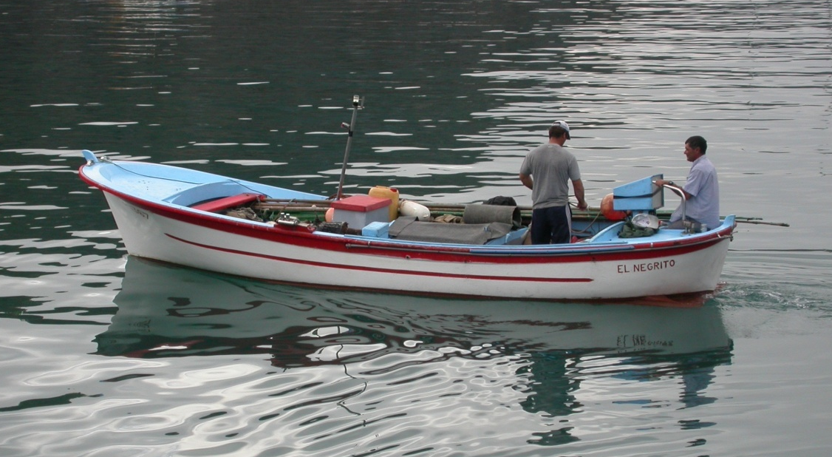
The fleet - Canary fishing grounds
Polyvalent and opportunistic alternation demersal-pelagic species
Most vessels <10 m length. Total number varies (~ 600-700 recent years)
Many landing sites along the archipelago
Sources: Project ORFISH (2017), STECF report IEO (Martín-Sosa 2012), Tuna team IEO

Slide 4
Landing composition – 2017 (official statistics – Firs Sale Notes)
DCF 2013 - Métier
SMALL PELAGICS
DCF 2015 - Métier
DEMERSALS
DCF 2003
Métier TUNA
IEO (Canary Oceanographic Centre) in charge of EU-DCF: Three MÉTIERS*
* MÉTIER: group of fishing operations targeting similar species, with similar gears
and/or seasonality, area and exploitation pattern

Slide 5
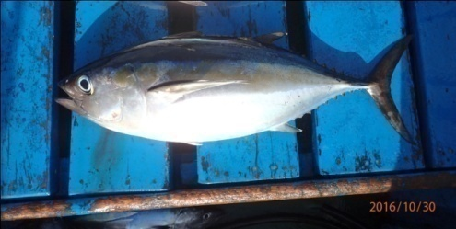
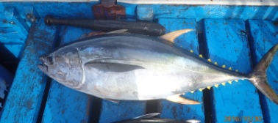
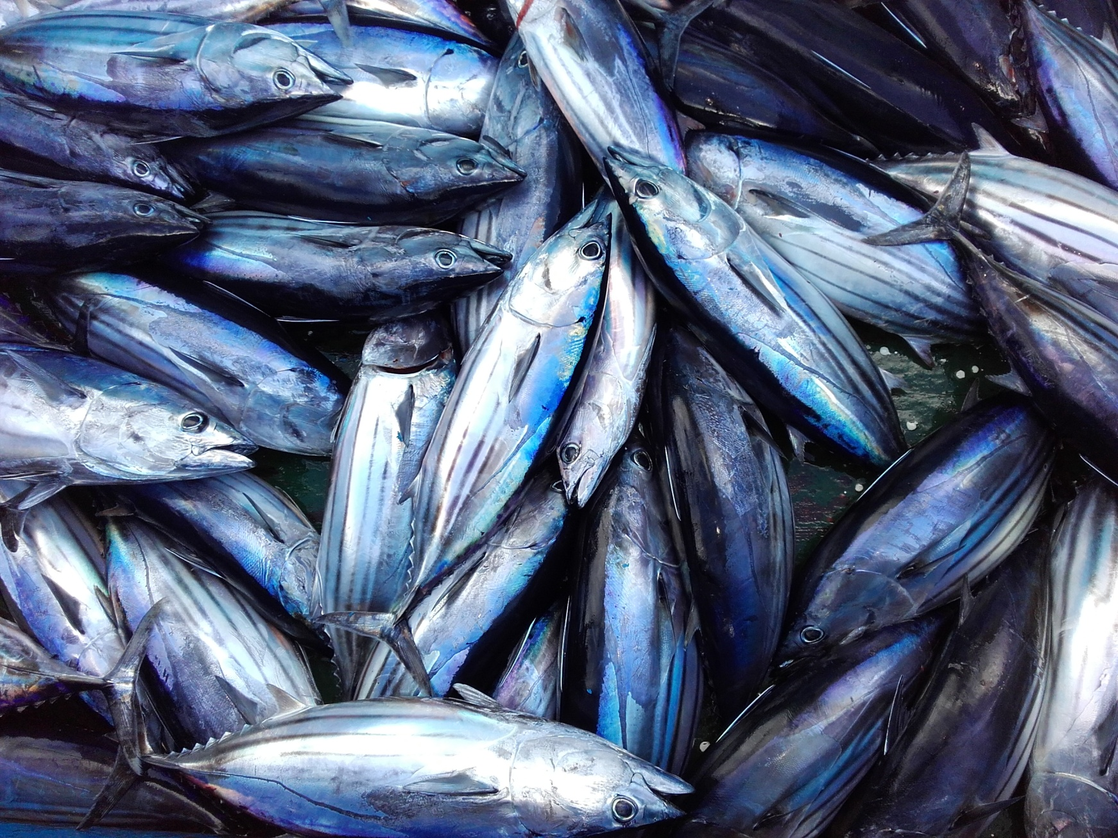
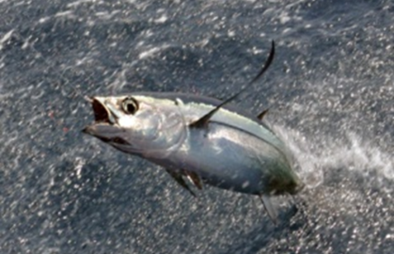
1. Métier of baitboats for TUNA - target species
Thunnus obesus - BIGEYE TUNA/tuna
Thunnus albacares - YELLOWFIN TUNA/rabil
Katsuwonus pelamis – SKIPJACK TUNA/bonito
Tunnus alalunga – ALBACORE/barrilote
Tunnus thynnus - BLUE FIN TUNA/patudo
Sources: Tuna team IEO; STECF REPORT (Martín-Sosa , 2012)

Slide 6
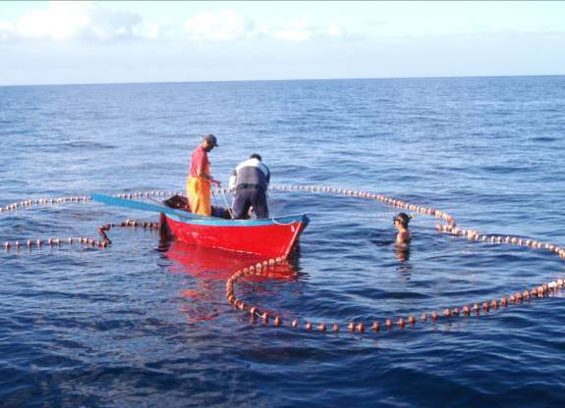
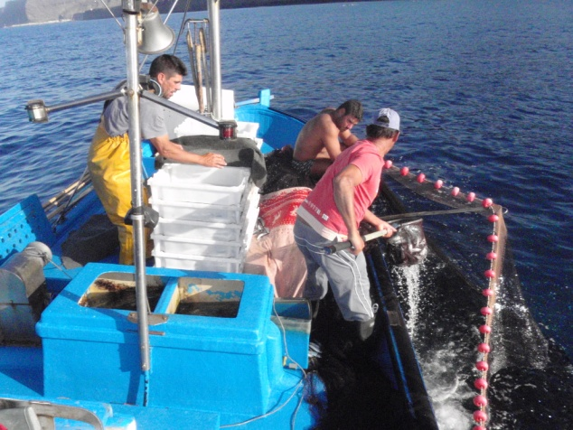
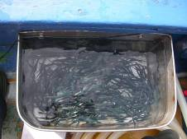
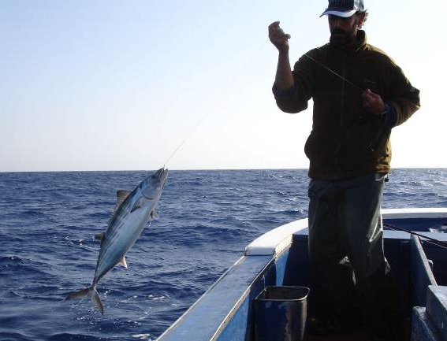
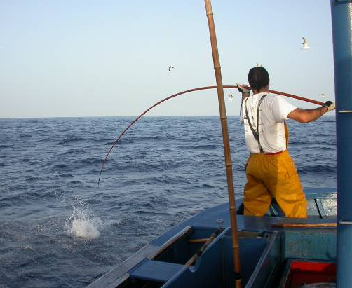
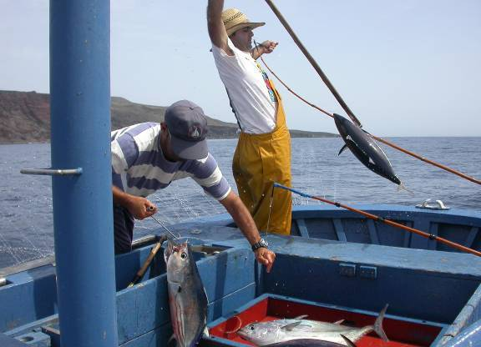
Baitboats using handline and pole-line
BAIT: purse seine fishing small pelagics as live bait
Sources: Tuna team IEO; STECF REPORT (Martín-Sosa , 2012)

Slide 7
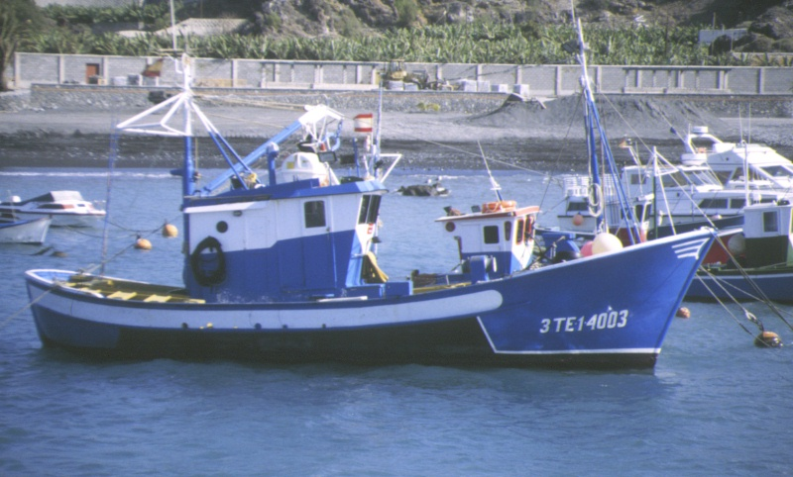
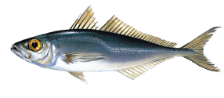
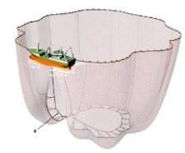
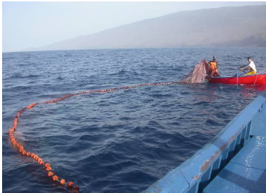
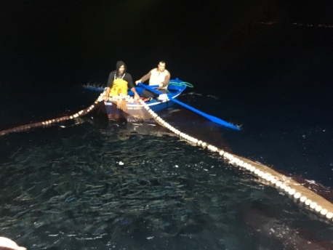
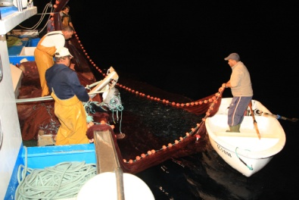
2. Métier – SMALL PELAGICS using purse seiners “traiñas”
Scomber colias - CHUB MACKEREL
Trachurus picturatus - BLUE JACK MACKEREL
Sardina pilchardus - SARDINE
Sardinella aurita - ROUND SARDINELLA
Sources: WG FAO small pelagics (Jurado-Ruzafa et al. 2015); STECF report IEO (Martín-Sosa, 2012), GEPETO project

Slide 8
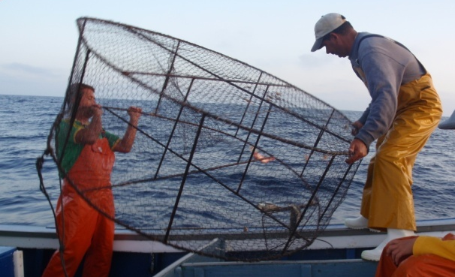
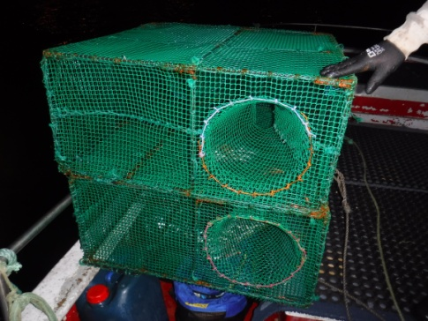
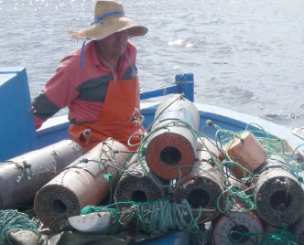
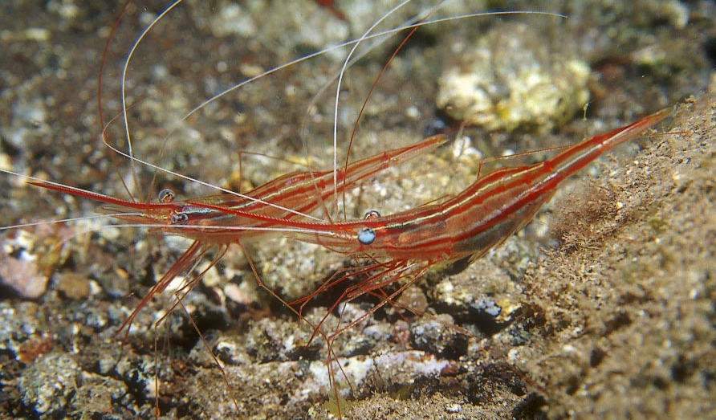
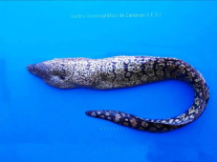
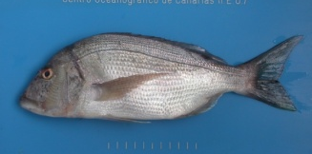
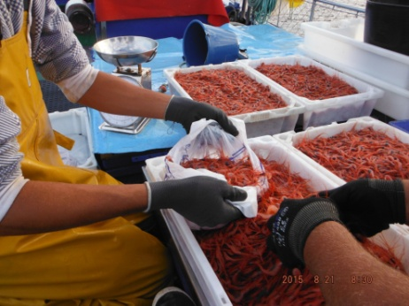
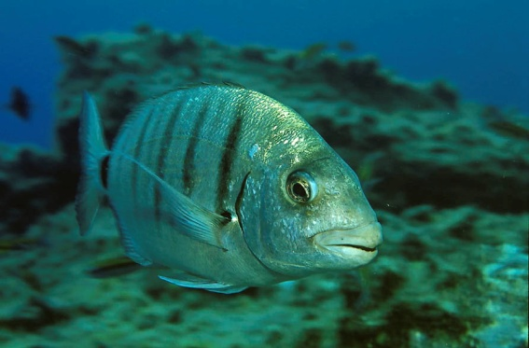
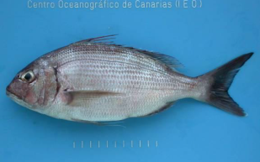
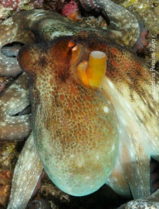
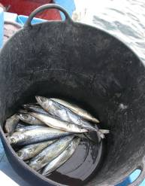
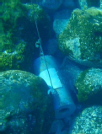
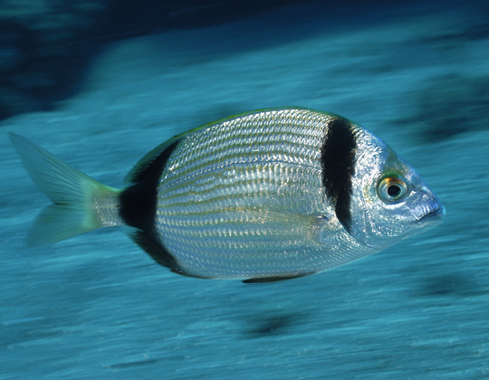
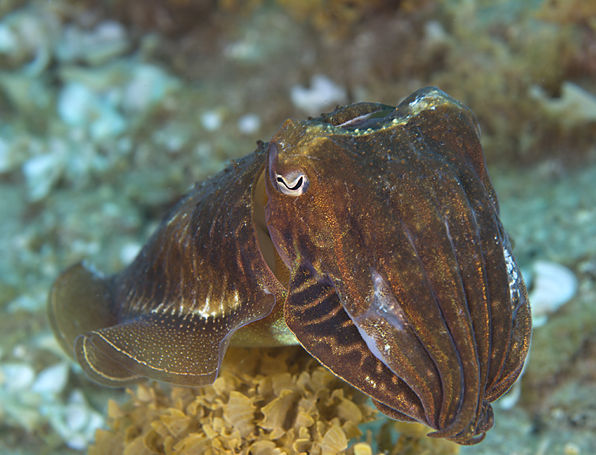
3. Métier DEMERSAL SPECIES using traps, lines, nets...
TRAPS-FISH: Sparisoma cretense, Sparidae, crabs, octopuses…
TRAPS-SHRIMPS: Plesionika spp. morays…
TRAPS-MORAYS: Muraena spp, Gymnothorax spp…
bait
Source: IEO Report of monitoring Marine Protected Areas (Falcón et al., 2010)

Slide 9
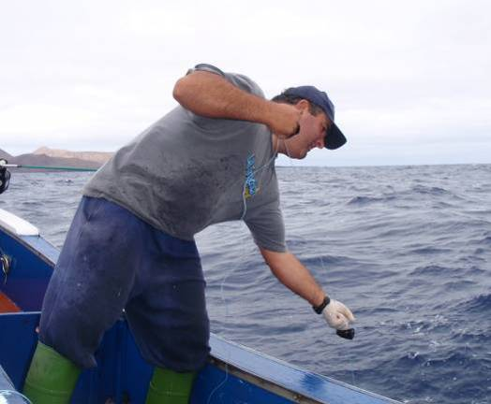
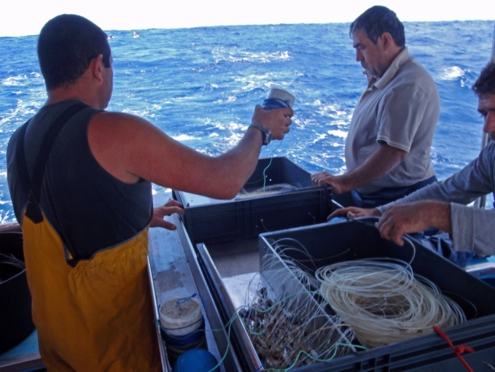
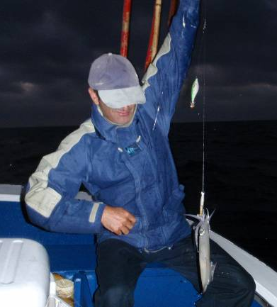
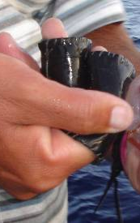
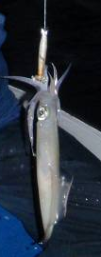
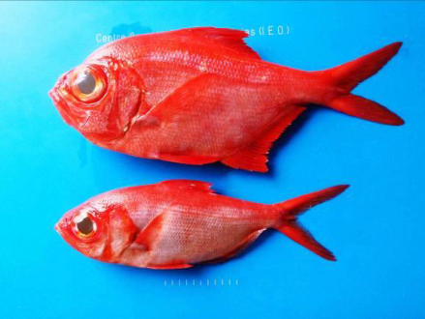
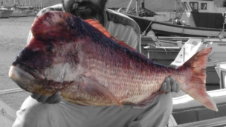
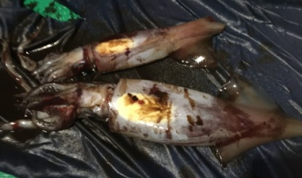
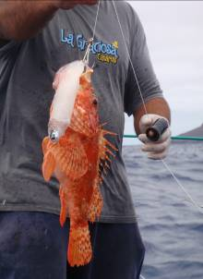
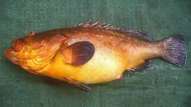
LINES
HANDLINE: Seriola spp, Dentex spp, Pagrus spp. Beryx spp, Serranidae…
LONGLINE: Beryx spp Merluccius merluccius, Phycis phycis, Scorpaenidae …
HANDLE JIGGING: squids (Loliginidae and Ommastrephidae)
Sources: IEO Report of monitoring Marine Protected Areas (Falcón et al., 2010)
Notes:
Liña de mano, palangre, potera

Slide 10
TRADITIONAL NETS
GILLNETS: Mullus surmuletus, Sparisoma cretense, Spondyliosoma cantharus, Pagellus bellotii, Diplodus sargus, Sarpa salpa…
SEINE / LIFT NETS: Sparisoma cretense, Boops boops, Thalassoma pavo, sand smelt and other coastal fish
Source: IEO Monitoring Reports of Marine Protected Areas (Falcón et al., 2010; González-Lorenzo, 2010)
Notes:
Redes de enmalle: trasmallo/cazonal
Redes izadas: pandorga o gueldera

Slide 11
DCF monitoring – sampling strategy
Concurrent * length sampling:
AT MARKET - tuna fish
ON BOARD of purse seine and demersal fleets (Tenerife): retained catch and discards
Stock-specific (target species): length sampling at market in most landing sites of Canary Islands
Biological sampling of target species (3 tuna and 4 small pelagics) in the lab. From 2016 age and growth of club mackerel was included in DCF Working Plans
* CONCURRENT SAMPLING STRATEGY : length structure of all species landed
Not only target species. ECOSYSTEM APPROACH

Slide 12
STATE OF PLAY – ACHIEVEMENTS
Characterization of Canary métiers under DCF directive for long-term monitoring
On board samplings and/or seasonal tagging campaigns. Fishermen cooperation
Good coverage of IEO sampling web in the main landing sites
Acoustic surveys launched by IEO since 2016 for a future assessment of small pelagic stocks
ASSESSMENT progress:
TUNA: assessment under the corresponding Regional Fisheries Management Organization (RFMO) for Atlantic tuna - ICCAT
SMALL PELAGICS: recently included by IEO in the corresponding RFMO - CECAF/FAO. Data from 2013 for future assessment.
DEMERSAL species: recently included by IEO in the corresponding RFMO - CECAF/FAO Data from 2015 and lengths of Sparisoma cretense for future assessment. Next CECAF/FAO WG of SSFs in July 2018
MANAGEMENT: IEO collaborates in the implementation of management measures

Slide 13
Gaps-Challenges
LANDINGS: gaps in First Sale Notes (fishing areas/gears, problems with species labeling, unreported catches…)
SAMPLING: limited coverage on-board and biological
SPECIES KNOWLEDGE: poor knowledge of biological cycle in most species (maturity size, growth pattern…)
ASSESSMENT: Additional complexity of demersal fishing operations (polyvalence and multi-species)
MANAGEMENT: Many management measures poorly based on scientific advice. New marine protected areas required

Slide 14
Next steps / recommendations
More collaboration with Fishery offices to implement the landing labeling (re-codification of wrong/grouped target species…)
Expand the current on-board samplings to eastern islands (e.g. Gran Canaria)
Demersal species: new biological studies of target species
DEPENDING ON THE AVAILABILITY OF STAFF AND FUNDS
Tuna: access to large sizes (price) and specialized staff in ageing, analysis of heavy metal composition (food quality for consumers)
DEPENDING ON THE AVAILABILITY OF STAFF AND FUNDS
GENERAL: Greater collaboration of all stakeholders (fishermen, scientific community, Canary fishery offices…) CO-MANAGEMENT STRATEGY
WITHOUT GOOD DATA FROM LANDINGS AND SPECIES BIOLOGY
NO RELIABLE ASSESSMENT IS POSSIBLE

Slide 15
Other current IEO activities in Canary ecosystems/fisheries
EU-Marine Strategy Framework Directive. Canaries marine demarcation. Implementation of good environmental status in the marine environment. www.mapama.gob.es
EU-EASME Marine Spatial Planning. Outermost Regions -Macaronesia MarSP. Development of MSP in line with the EU Directive on MSP (2014/89/EU) and following an Ecosystem Based Approach. www.msp-platform.eu/projects
UE-MARE Project ORFISH: Development of innovative, low-impact offshore fishing practices for small-scale vessels in outermost regions www.orfish.eu
EU-Life project INTEMARES: integrated management of marine protected areas. www.fundacion-biodiversidad.es
EU-INTERREG Atlantic project CEPHS & CHEFS: Octopus, squid, cuttlefish, sustainable fisheries and Chefs. www.cephsandchefs.com
WG of experts (International Council for the Exploration of the Sea – ICES): Small pelagics, cephalopods. www.ices.dk

Slide 16
Thanks for your attention
Gracias por su atención
Merci votre attention
Thanks to the Fishermen‘s Associations of Canary Islands for their collaboration in DCF
Funded by Spanish Government and EU-Data Collection Framework

