Slide 1
BLUE ECONOMY IN THE CANARY ISLANDS: an OPPORTUNIty
Pedro Ortega Rodríguez
Regional Minister of Economy, Industry, Trade and Knowledge

Slide 2
BLUE ECONOMY IN THE CANARY ISLANDS
● The marine-maritime sector represents more than 7% of the regional GDP.
● It employes more than 45.000 workers.
● In parallel to traditional activities, new industrial development poles have been developed.
● Due to their geostrategic position, the canary ports are now: cruise lines bases of operations, first level logistical centers in container transfers, fuel supply (bunkering), provisions, ship repairs, etc.
● Due to their insular dimension, and possesing more than 20% of the Spanish coastline, the Canary Islands are natural test laboratories in the marine energy technologies (off-shore wind and wave energy), and marine biotechnology sectors.

Slide 3
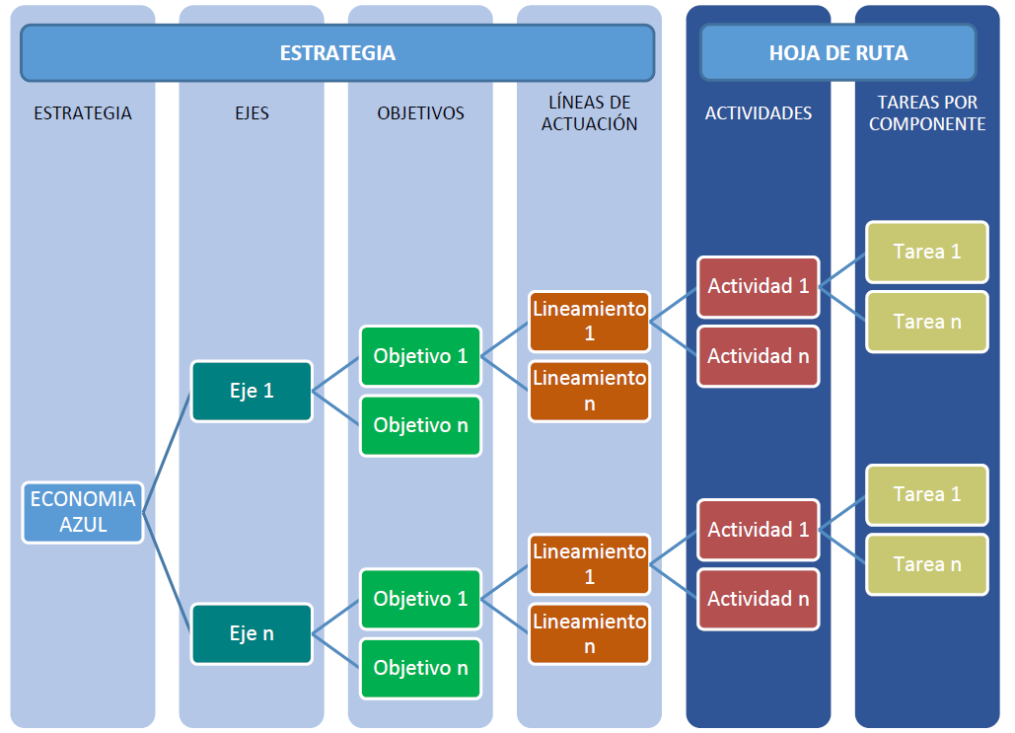
CANARY ISLANDS BLUE ECONOMY STRATEGY

Slide 4






TERRITORIAL COOPERATION PROGRAMME INTERREG MAC 2014-2020
● Approved by the European Commission on 3rd June 2015, with a total budget of 130 M€.
● 215 cooperation project proposals presented to the first call by institutions of the MAC area. 56 projects approved with a total ERDF budget of 54.264.385 €.
19 projects directly related to Blue Economy
Renewable Energies
Gastronomy of Sea Products
Business Activity in the maritime sector
R&D&I
Tourism
Desalination Technologies

Slide 5
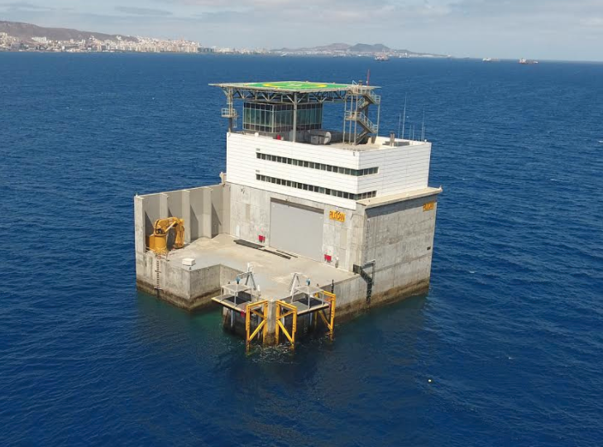
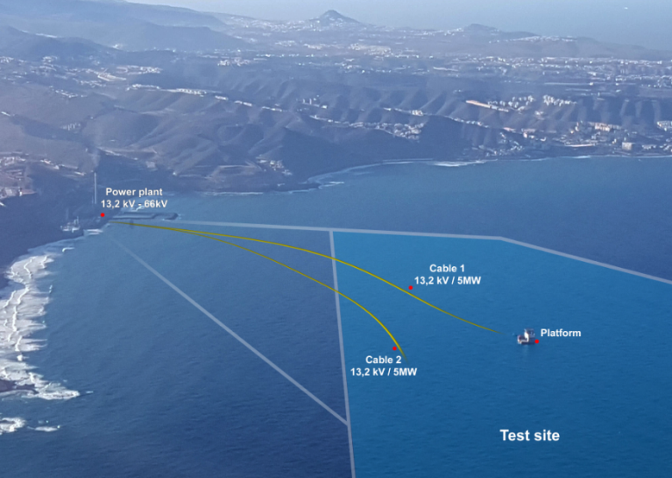
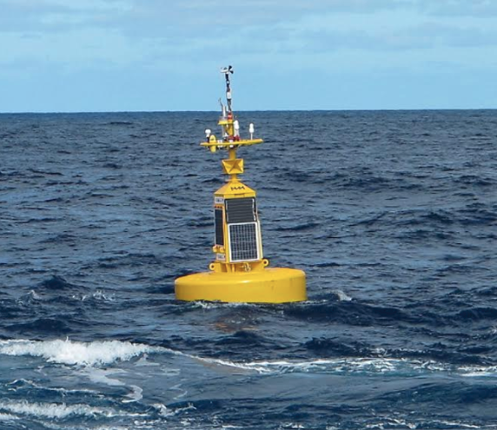







PLOCAN
INSTALLATIONS
PROJECTS

Slide 6





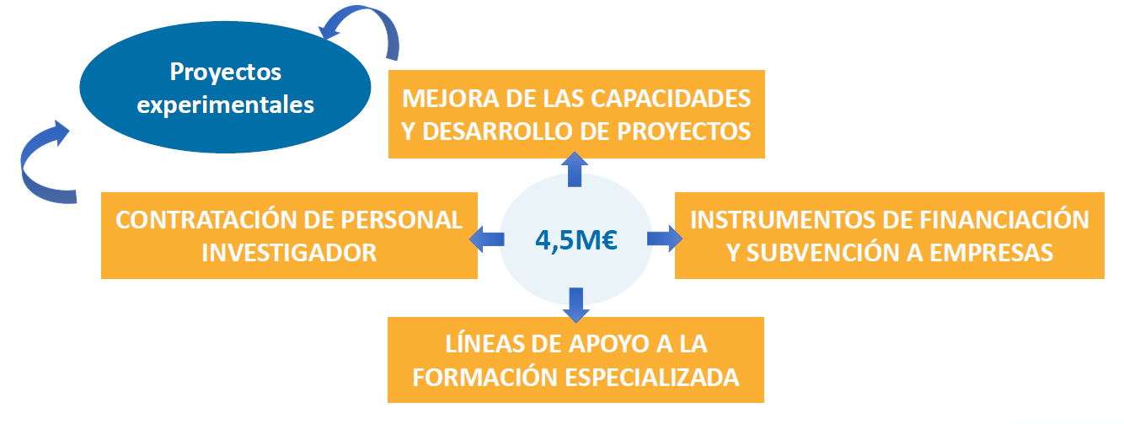
BIOASIS. PLATFORM FOR BLUE BIOTECHNOLOGY AND AQUACULTURE
● Joint Initiative of the Canary Islands Regional Government, the Gran Canaria Insular
Council and the University of Las Palmas de Gran Canaria.
● Promotion of the marine biotechnology and aquaculture sectors.

Slide 7
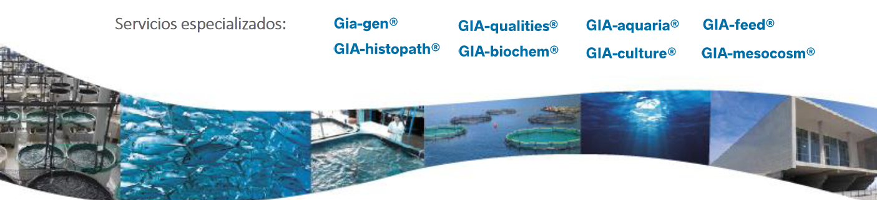
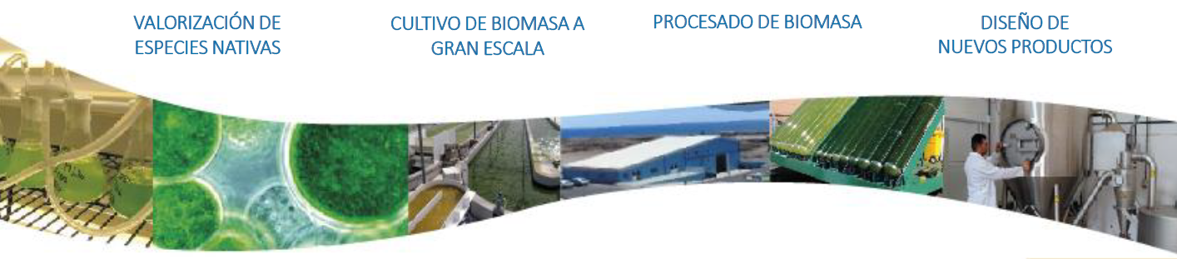
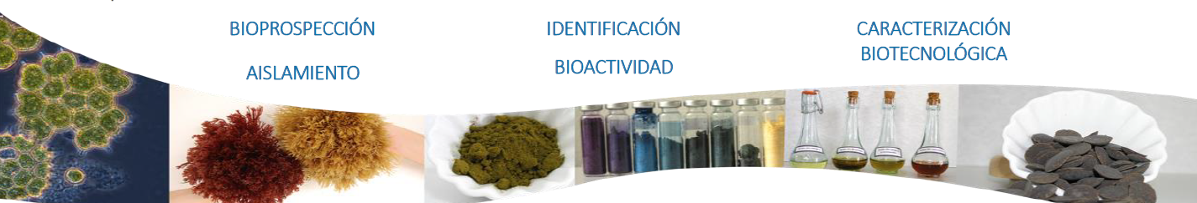
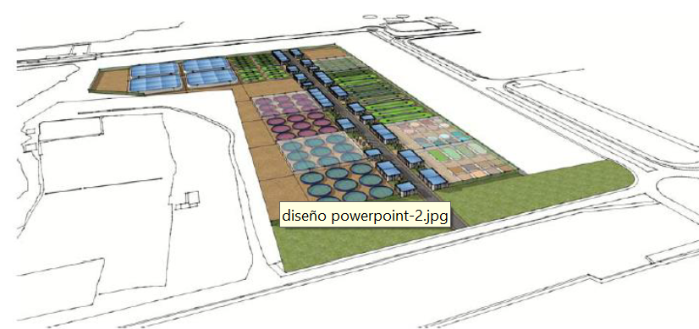
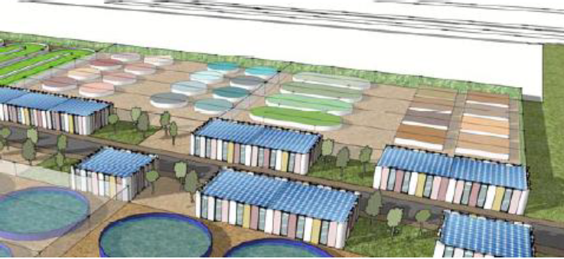
BIOASIS. PLATFORM FOR BLUE BIOTECHNOLOGY AND AQUACULTURE
SCIENTIFIC RESEARCH AREA
INCUBATION AND EXPERIMENTATION AREA
TECHNOLOGICAL DEVELOPMENT AND INDUSTRIALIZATION AREA

Slide 8
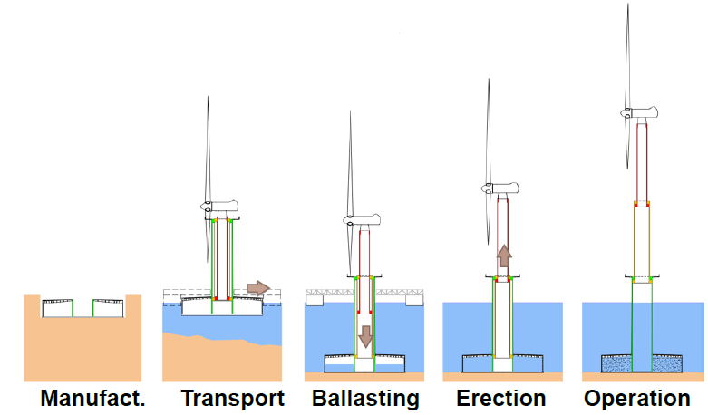
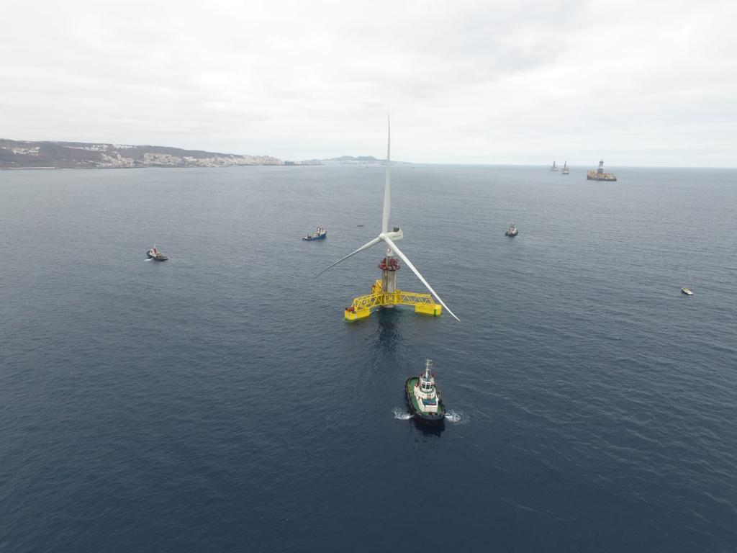
OFF-SHORE WIND ENERGY IN THE CANARY ISLANDS.
ESTEYCO PROTOTYPE
● Design of an off-shore wind tower based on a concrete structure that can be fully mounted onshore.
● The main objetive is the construction of an off-shore tower for a 5MW turbine at 30 m depth
● Prototype cofinanced by the European Commission (“Horizon H2020” programme) through two differentiated, but connected, projects (H2020 SME ELISA and H2020 LC3 ELICAN)

Slide 9
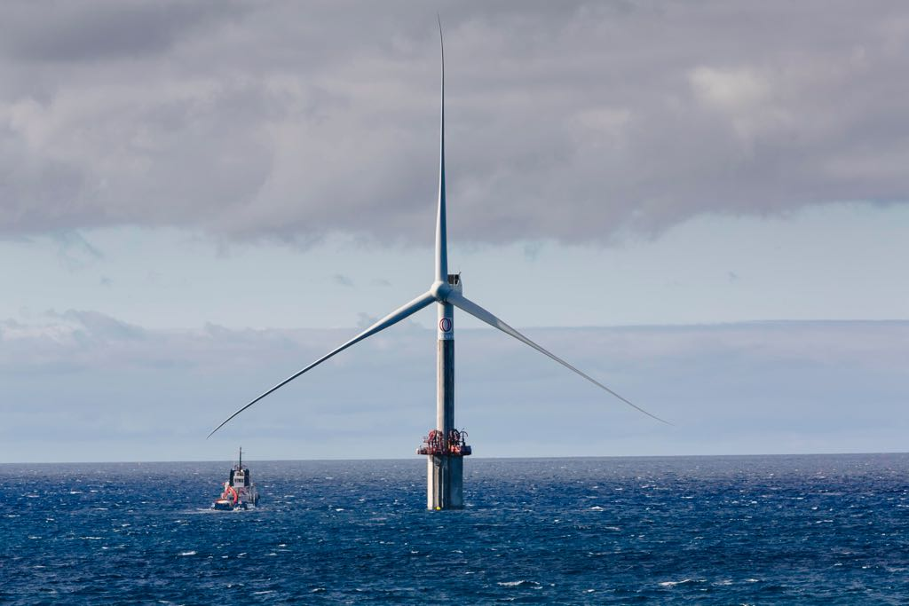
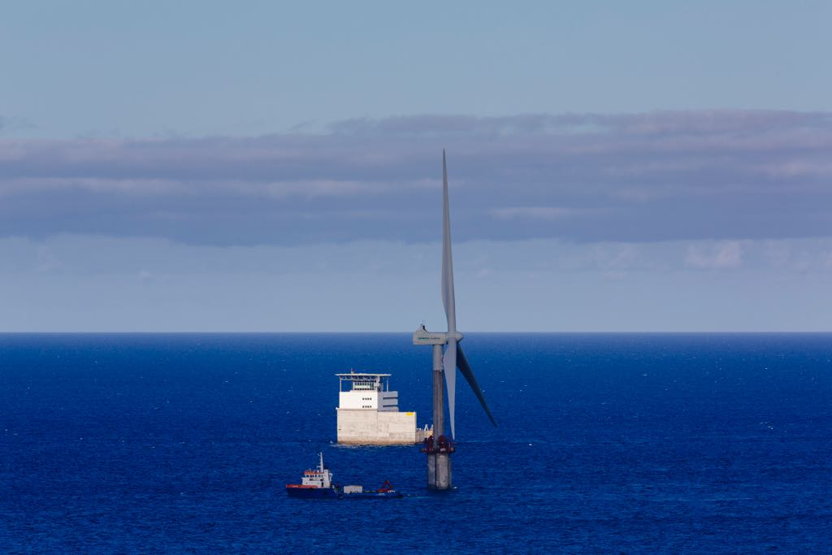
OFF-SHORE WIND ENERGY IN THE CANARY ISLANDS. FROM THE PROTOTYPE TO THE EXPERIMENTAL PLATFORM
● Impact of the wind infrastructure in the marine environment. Aquaculture, behaviour of marine life…
● Erosion studies with different anti-scour techniques.
● Sea vs. Land behaviour analysis of wind infrastructures
● Maintenance: new methods and processes
● Off-shore PV energy combined with wind energy

Slide 10
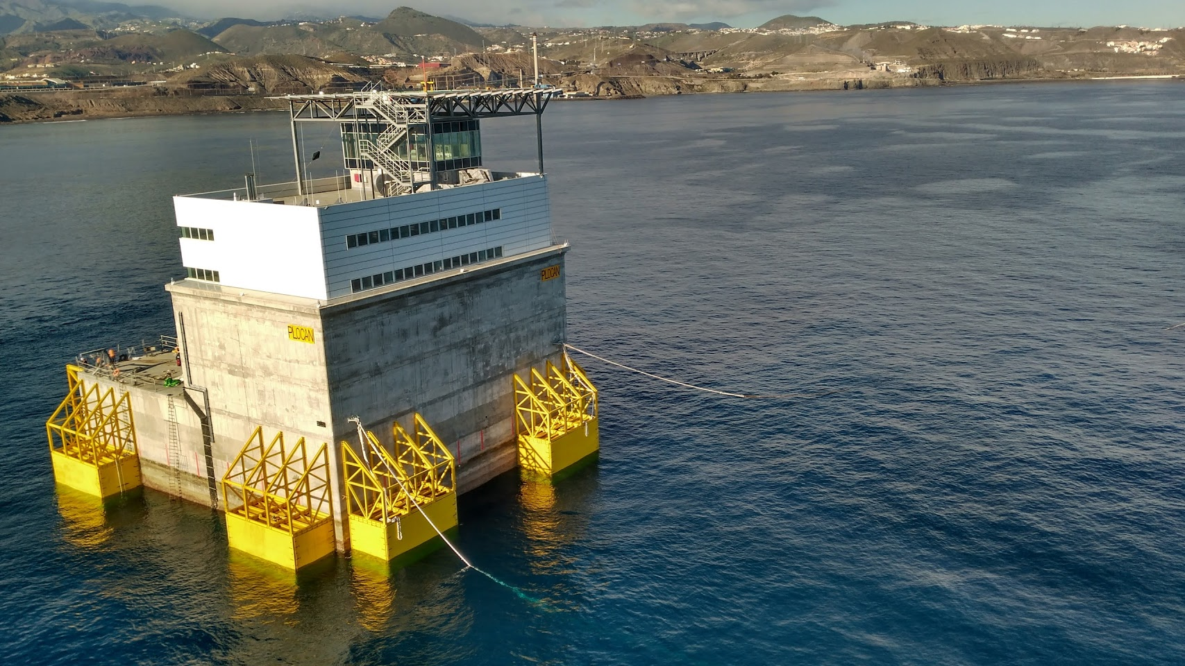
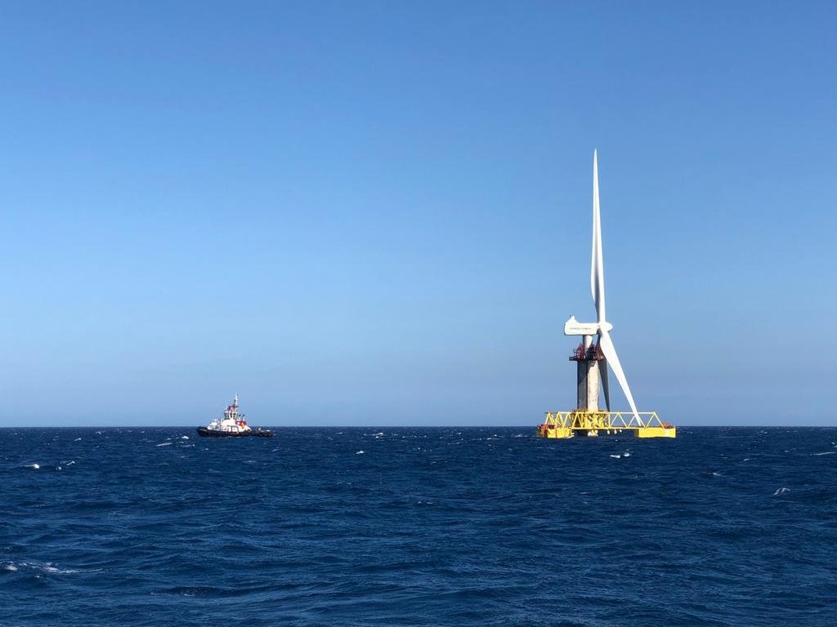
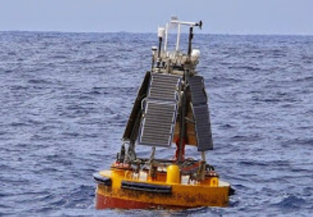
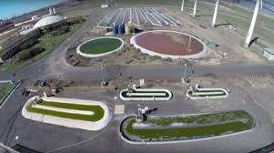
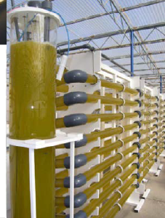
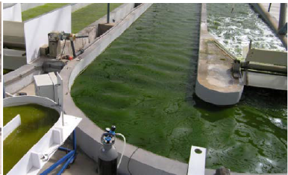
A BLUE ECONOMY NATURAL LABORATORY

