Slide 1




Perspective for improving assessment of small-scale fisheries in ORs
Olivier Guyader, Lionel Reynal
Notes:
The communication is about participative methods involving fishermen in the case of moored fish aggregating devices

Slide 2
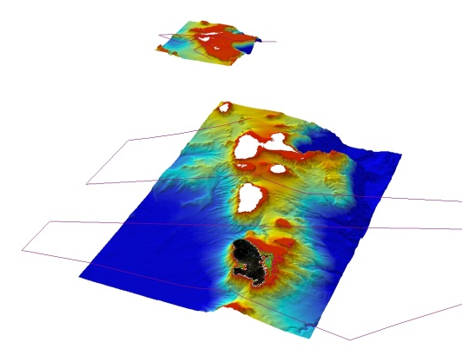
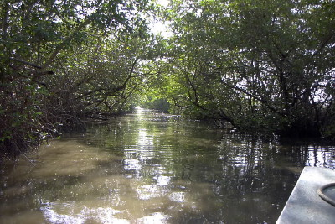
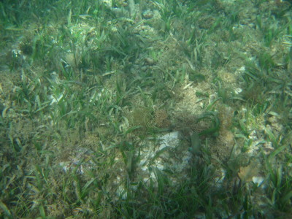
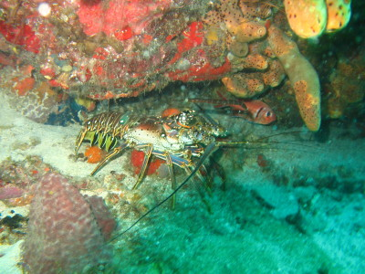
Except French Guyana, all outermost regions are small islands with large EEZ but narrow insular shelves, high spots of biodiversity:
Benthic and demersal resources sensitive to overexploitation
Economic Exclusive Zones (EEZ) and bathymetry
Lesser Antilles EEZ and bathymetry
Mangrove swamps
Martinique : 1 850 ha
Guadeloupe : 3 000 ha
Seagrass [0 à 30 m]
Martinique : 4 140 ha
Guadeloupe : 9 730 ha
65 species
10 to 30kg / ha
Coral reef [0-50 m]
Martinique : 5 587 ha
220 species
1 893 kg / ha
(Bouchon et al., 2002)
Mangrove swamps
Martinique : 1 850 ha
Guadeloupe : 3 000 ha
Mangrove swamps
Martinique : 1 850 ha
Guadeloupe : 3 000 ha
Canaries Islands
Except French Guyana, all outermost regions are small islands with large EEZ but narrow insular shelves, high spots of biodiversity:
Benthic and demersal resources sensitive to overexploitation
87 species
10 to 300 kg / ha

Slide 3
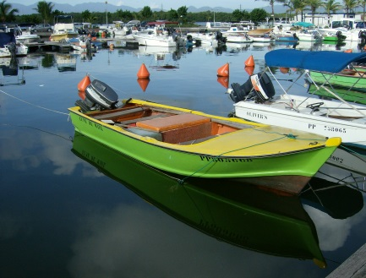
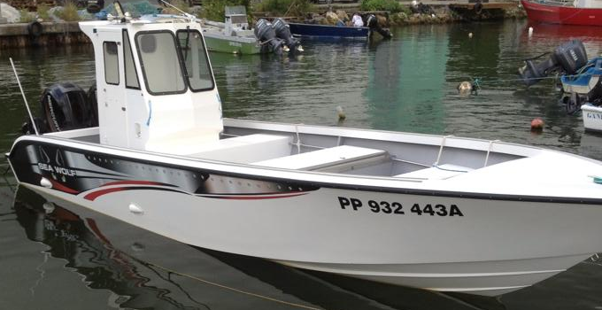
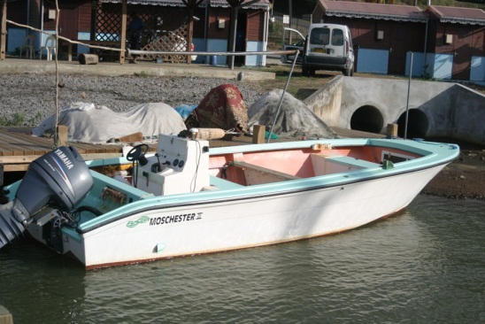
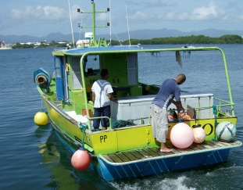
Context: mainly a small scale fleet (SSF)
All French ORs
SSF are low intensive in capital
Reduction in lower size categories
But increase in the average engine power,
in vessels investment cost over the last 20 years
Most of the vessels do one day trips (livelihoods) except [10-12[m vessels

Slide 4
Context: landings per group of species
Quantities
Large pelagic species
Most of the landings sold to consumers, fish mongers, restaurants
Competition from imports of sea products
Values

Slide 5
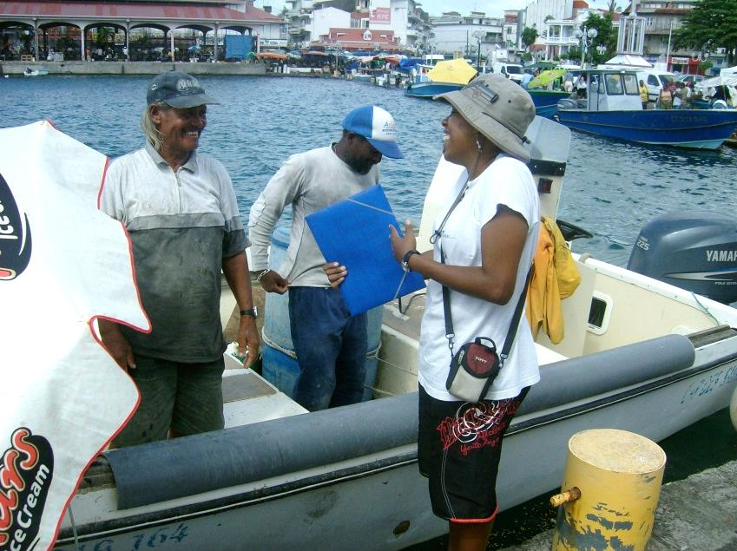
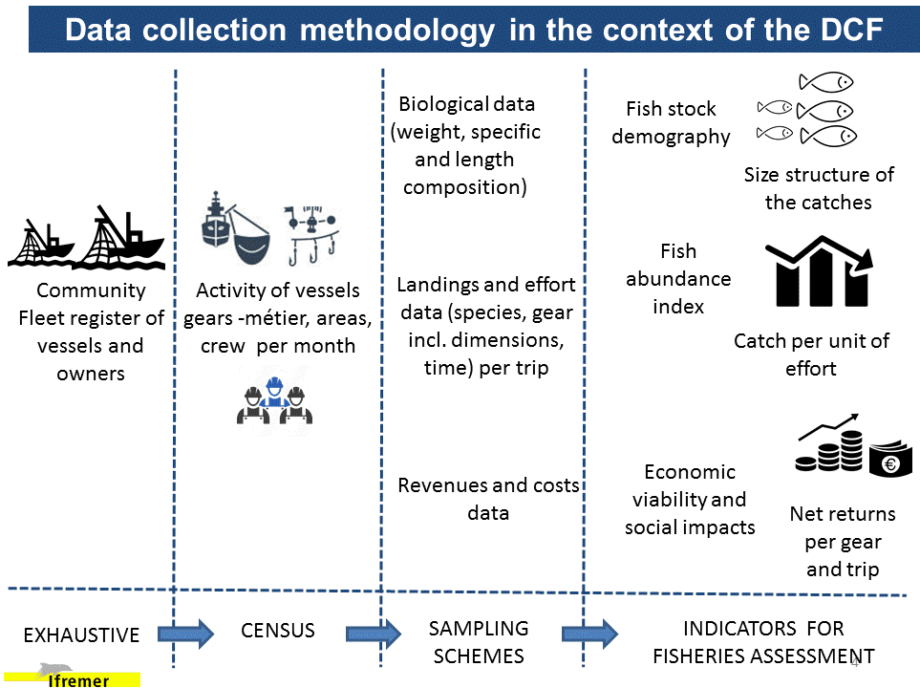
Context : difficulties to follow SSF
Even if improving, difficulties of collecting log-books/fishing forms by the administration
No auctions system including registration of landings (direct selling to consumers)
High number of landings sites
High number of landings with small quantities landed (variability)
Establishment of data collection system in the mid of 2000s
2-5 permanent observers per French OR
On site data collection
Statistical methods

Slide 6
Challenges
How to improve data collection on fishing effort, landings, socio-economics of SSF (incl. recreational & informal)?
How to assess coastal fishing stocks in multispecific and high biodiversity context?
What kind of recommendation for fisheries management?

Slide 7

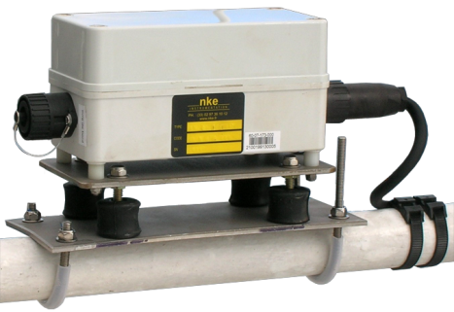
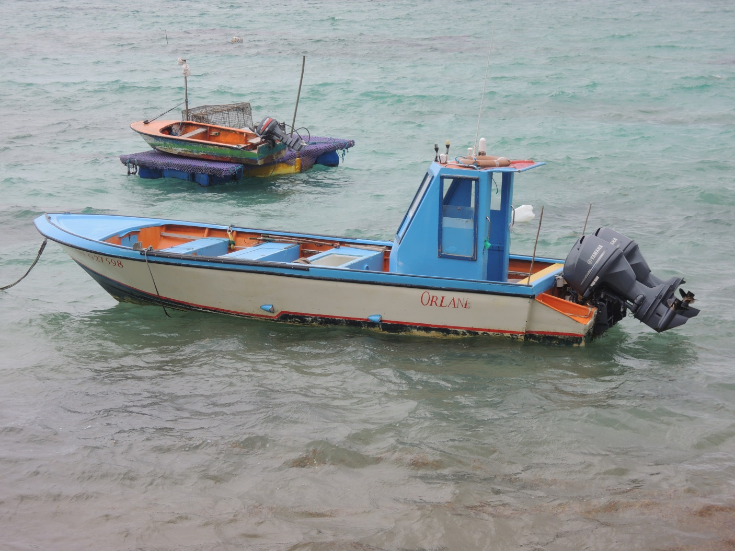
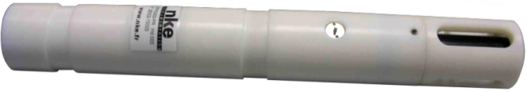
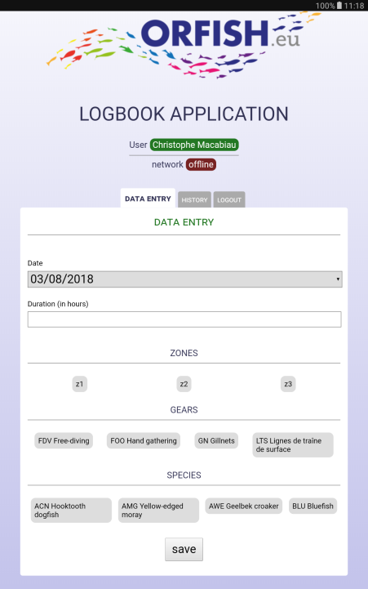
1. Collaborative project between scientists-fishers using low cost technologies (8 vessels)
Data center
Beacon
With GPS,
Transmission of data GPRS
Pressure sensor /
Temperature / (salinity))
Measure of gear fishing effort and physical parameters at the bottom and along the water column
Landings transmission through e-forms
Landings and price per species, prices, occurrence of Sargassum algae

Slide 8
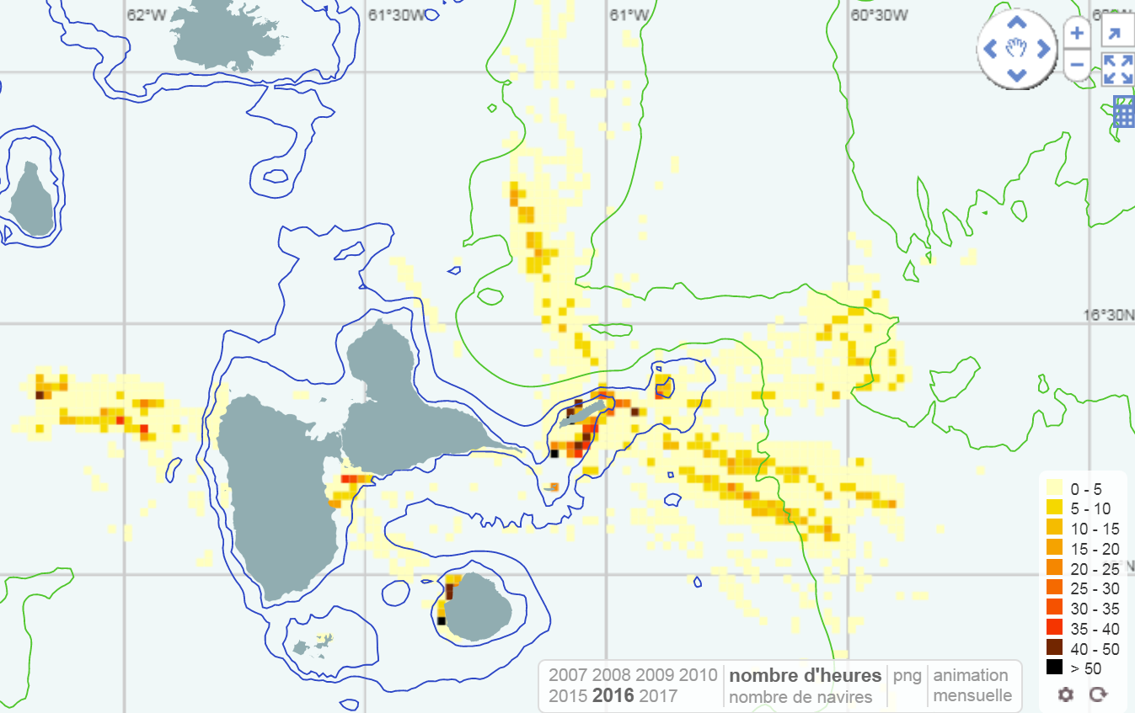
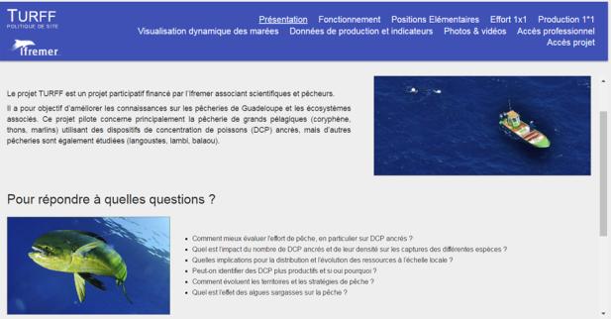
1. Collaborative project between scientists-fishers using low cost technologies
An improved assessment of fishing effort and distribution
Data sharing with fishers
Nominal fishing effort (hours at sea) for the vessels equipped with GPS
Web site with fishers access to their own data
Generalization to the fleet of small scale vessels at OR level
Notes:
One of the output of this project is a collaborative website. This website includes a trip visualization software which is still under progress
Here is a video of a selected trip we can go through without many comments

Slide 9
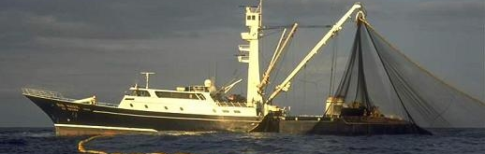
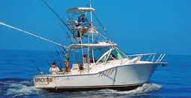
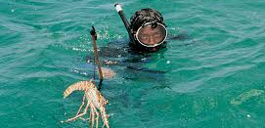
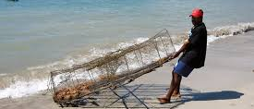
1. Need for a better understanding of competitors
Few studies on recreational fisheries and few attempts to deal informal fishers
Assessment of interactions with competitors over all ORs based on expert knowledge
Develop pilot studies on drivers of these fisheries and effort-catch estimates
Establish licences, permits
Source: ORFISH

Slide 10
Challenges
How to improve data collection on fishing effort, landings, socio-economics of SSF (incl. recreational & informal)?
How to assess coastal fishing stocks in multispecific and high biodiversity context?
What kind of recommendation for fisheries management?

Slide 11
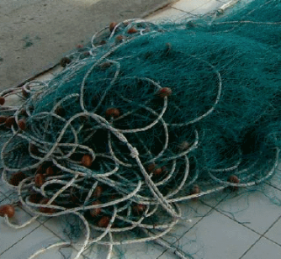
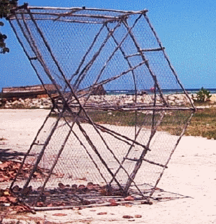
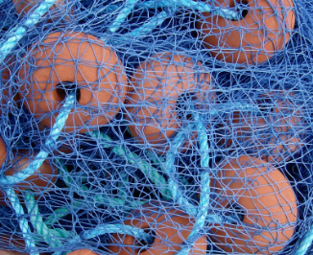
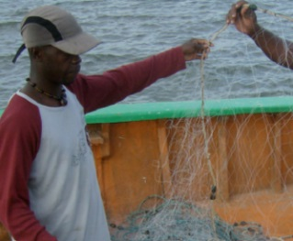
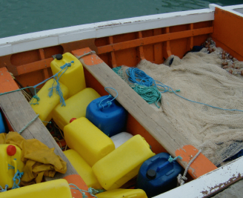
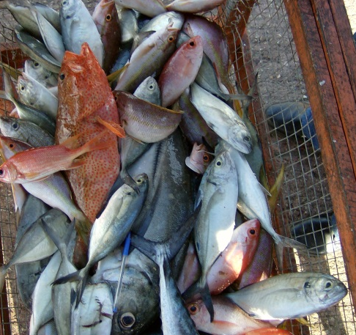
Multi-gears Multi-species fisheries
High diversity of gears used in coastal fisheries (with different gear selectivity pattern)
High species diversity in the landings (182)
% of demersal catches
No clear dominant species in the landings except some species (conch, spiny lobster, …)
Species rank

Slide 12
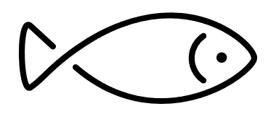
Assessment of demersal species for operational management
Structure of the landings at the beginning of the fisheries exploitation
Current structure of the landings
Fishing effort * gear selectivity
Rarefaction of large species
Sharp decline in medium species
How to determine exploitation rates to recover maximum sustainable yield for this set of species?
→ Data collection sampling plans, assessment models (share scientific expertise between OR)
Notes:
Develop sampling approaches & models for the assessment of demersal fisheries (dedicated projects involving all ORs)
Quantitative assessments of the most abundant species in the catches failed to diagnose overexploitation that threatened growth potential (Gobert, 1989). This is probably due to the fact that these species dominate catches precisely because their average size is compatible with the selectivity of the fishing gear used, whereas the possible overexploitation of rare or absent species in catches is more difficult to implement. evidence. This is the case for most large species (including some Serranidae and Scaridae), which are now practically non-existent in the fishery. Fishing pressure thus determines the composition of a multispecies stock (relative abundance of species), in the same way that it determines the size structure of a monospecific stock (Gobert and Reynal, 2002).
How to determine the mesh size of the gear and the optimal catch size to obtain a maximum sustainable yield of this set of species?

Slide 13
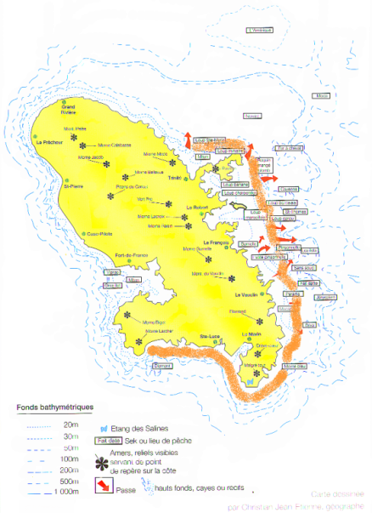
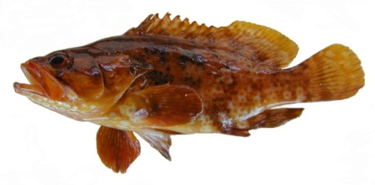
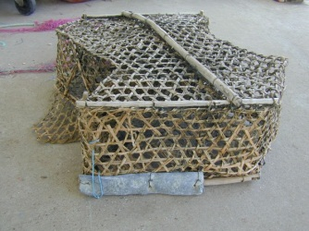
Assessment of demersal species for operational management
Few studies on the spawning areas and more generally on the biology (life cycle) of species
Area of fishing and spawning of Alphestes afer (red line) based on a collaborative study with fishers
Alphestes afer (red line) but also
Epinephelus adscensionis Cephalopholis cruentatus C. fulva
Evolution of a fishery to the trap called “Tombé lévé" to net fishing (1990s)
→ Development of projects involving fishers local knowledge

Slide 14
Challenges
How to improve data collection on fishing effort, landings, socio-economics of SSF (incl. recreational & informal)?
How to assess coastal fishing stocks in multispecific and high biodiversity context.
What kind of recommendation for fisheries management ?

Slide 15
Basically, fisheries management is (or should be) composed of two complementary types of measures:
Conservation :
Selectivity of catches, gears, MPAs
Preservation of productive / reproductive capacity of stocks (and habitats)
Total Allowable Catch, capacity (kW, GT)
Licences with effort regulation per métier
Landings quota / vessel
Territorial use rights (TURF)
Access regulation :
Allocation of this capacity among harvesters to avoid overcapacity
Most of the fisheries are in open access situation → still race for fish → rent dissipation
Review management measures & governance in the ORs
Promote of co-management (administration, fisheries, scientists, other stakeholders) ?

Slide 16
Conclusion
Similar socio-ecosystems in the ORs evolving in a context of climate change
Similar issues (knowledge, management, …)
Develop exchanges and cooperation between scientists working on the ORs
Also a need for integrated assessment of fisheries (biologists, economists, socio-)
Involve stakeholders

Slide 17
Thank you for your attention
Reduce competition for the resource

