Slide 1


Maritime Alliance for fostering the European Blue economy through a Marine Technology Skilling Strategy.
The integration of Azores region in the Strategy development.
Workshop: Realising the potential of Outermost Regions for sustainable blue growth. Outermost Regions Forum. Brussels, 26th June 2018.
Co-funded by the
Erasmus+ Programme
of the European Union
The European Commission support for the production of this publication does not constitute an endorsement of the contents which reflects the views only of the authors, and the Commission cannot be held responsi­ble for any use which may be made of the information contained therein.

Slide 2

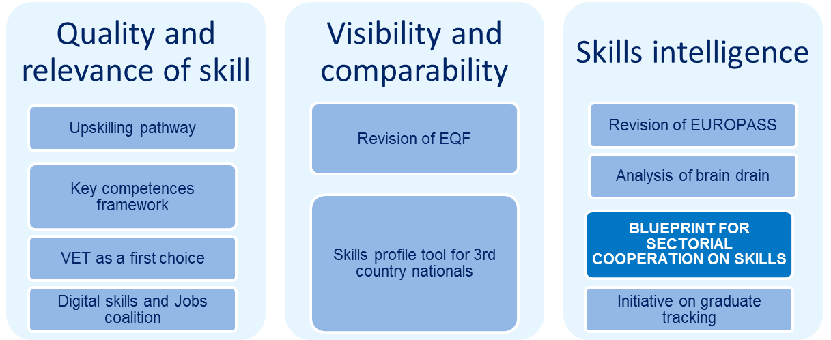
NEW SKILLS AGENDA FOR EUROPE
Sector Skills Alliances between education and training providers and the world of work aimed at promoting employability, contributing to the creation of new sector-specific or cross-sectoral curricula, developing innovative methods of vocational teaching and training and putting the Union transparency and recognition tools into practice.
Co-funded by the
Erasmus+ Programme
of the European Union
The European Commission support for the production of this publication does not constitute an endorsement of the contents which reflects the views only of the authors, and the Commission cannot be held responsi­ble for any use which may be made of the information contained therein.
Notes:
Sector Skills Alliances are an instrument to contribute to the New Skills Agenda for Europe , and in particular to improve the quality and relevance of Europe’s Vocational Education and Training. The Blue Print for sectoral cooperation on skills is one of the 10 actions of the New Skills Agenda for Europe and the call KA2, above referred
Sector Skills Alliances aim at tackling skills gaps with regard to one or more occupational profiles in a specific sector. They do so by identifying existing or emerging sector-specific labour-market needs (demand side), and by enhancing the responsiveness of initial and continuing vocational education and training (VET) systems, at all levels, to the labour market needs (supply side).

Slide 3
BASIC FACTS AND FIGURES
ENCOMPASS THE MARITIME TECHNOLOGIES WITH A STRATEGY FOR TACKLING SKILLS’ SHORTAGES
ENCOMPASS THE MARITIME TECHNOLOGIES WITH A STRATEGY FOR TACKLING SKILLS’ SHORTAGES
4 YEARS OF ACTIVITY: 2018 – 2021
17 PARTNERS, 8 EU COUNTRIES
4,9 M€ BUDGET
80% CO-FINANCED BY ERASMUS + PROGRAM
11 PILOT ACTIONS
1 LONG TERM STRATEGY & ACTION PLAN
Notes:
MATES’ objective is to develop a skills strategy that addresses the main drivers of change to the maritime industry, in particular the interlinked value chains of shipbuilding and offshore renewable energy, which require adaptation and evolution to succeed in an increasingly digital, green and knowledge driven economy.
To address the challenges of the present and future skills and training gaps in these sectors, these are the basic facts an figures of our project.

Slide 4
THE VALUE CHAIN APPROACH IN MATES
EDUCATION & TRAINING
INDUSTRY
Shipbuilding
Offshore Renewable Energies
Related Manufacturers & developers
Life Long Learning
Professional Training
Vocational Training
Higher Education
Secondary Education
Skills’ Gaps-
STRATEGY & ACTION PLAN
SERVICES
Engineering
Consultancy
R&D
Operations & Maintenance
Environmental Services
Logistics
(,,,)
Platforms and training mechanisms
Mobility
Professional profiles
Design of trainings
Digital skills
Green skills
Innovation skills
Ocean Literacy
Notes:
We interpreted that the maritime technologies value chain should be understood for the MATES project in a broad sense, focusing on two pillar industrial sectors, shipbuilding and off-shore renewable energy, but including all their intersections and all associated activities and services.
We considered that only with such an integrative approach we could be able to design a sufficiently broad and inclusive strategy. To make it then roll out and have an impact at the States and regional levels, the project structure and the consortium composition are the two other key elements for achievement.

Slide 5



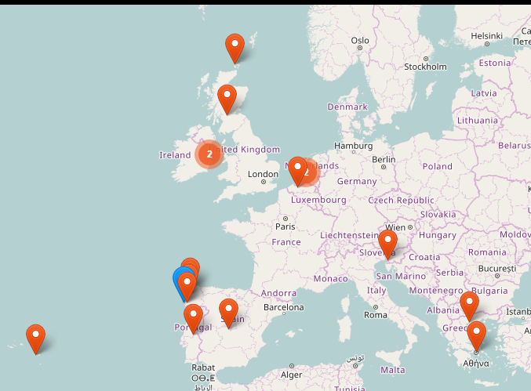














Notes:
Partnership will have a node in all major European sea-basins including the Outermost Region of Azores.
MATES is involving: training and education organisations, research institutions, industry representatives, consultancies, with a significant geographical coverage but also with a wide knowledge background…

Slide 6
Project structure
WP7: Quality control and risk management
WP8: Overall coordination & management
WP4: Practical Pilot
Experiences (PEs)
Mobility
New curricula and
professional profiles
New trainings
Digtal skills
Green Skills
Innovation management
Ocean Literacy
Maritime hackaton
WP1: Stakeholders’
mobilisation
WP5: Critical
revision and
long-term
industry-led
Action Plan
WP2: Baseline strategy& foresight
WP3: Prioritisaion and action lines
CHECK
PLAN:
Preliminary strategy for bridging current and future skills needs
Do: Test
ACT:
Long-term
industry lead
Action Plan
Do: Test
DO: Test
WP6: Dissemination and outreach
Co-funded by the
Erasmus+ Programme
of the European Union
The European Commission support for the production of this publication does not constitute an endorsement of the contents which reflects the views only of the authors, and the Commission cannot be held responsi­ble for any use which may be made of the information contained therein.
Notes:
MATES adopts the well-known Edwards Deming Circle for permanent improvement: Plan, Do, Check, Act (PDCA) (Which at the same time is totally aligned with the principles of EQUAVET)
The work plan will start with the mobilisation of stakeholders beyond the project to broaden the partnership capacity to carry-out the work, assure sustainability, multiply impact, and obtain continuous feedback. They will be invited to contribute to assess the current and future situation of the sectors and its implications for the labour market regarding skills’ needs and employability.
From a comprehensive assessment and foresight analysis a prioritization of action lines will be made in a preliminary strategy document (Plan) and a number of Pilot Experiences will be planned and launched to contribute to these action lines and test the strategy (Do).
Critical revision of the pilots and their results confronted with the preliminary strategy design will allow a fine tuning (Check) and the set-up of a Long-Term Action Plan (Roadmap).
The action plan will assign responsibilities and reflect commitment by those partners and external stakeholders which will harness and mainstream the strategy and its recommendations in the long term (in the horizon of the 2030) (Act).
This work plan design is also fundamental to guarantee that the project touches the ground of the regional and local context and actors and generates impact at this level, underpinning also the Regional Specialisation Strategies (RIS3). This is essential to get sufficient involvement of key actors in these contexts to upscale the strategic design (at EU level and with long term perspective) and ensure sustainability.

Slide 7
Thematic approach
Objective: Match demand and supply of skills
INDUSTRY - LED // DEMAND DRIVEN
SHIPBUILDING
OFFSHORE
RENEWABLES
SKILL GAPS on the managerial and operational levels
Digital skills
Green skills
Automation
Robotics
Big Data & Data Analytics
Cloud computing
3D Printing
Internet of Things
Sustainable practices
Reduction of carbón emissions
Recycling
Efficient use of ressources
21st Century skills
Gender Balance
Revision of specific technical CV
Specific occupational profiles:
Skills
Proficiency level
OCEAN LITTERACY
Promote knowledge exchange to & from industry Raise awareness about the maritime industry’s careers for society
Knowledge Transfer
Innovation / Knowledge management
Entrepreneurship
Funds rising
VET Standards & Governance
Notes:
From a thematic perspective a special attention will be paid to the gaps regarding: Digital (and data enabled) skills , Green skills ,and innovation and knowledge management skills (the so called 21^{st century skills) .}
The project will guarantee an appropriate follow up of the project’s policy on gender balance, equity and inclusiveness .
Finally, the Project will assure the application of VET standards on its outputs and the transmission of results and search for schemas of financement of iniciatives beyond the Project .
Ocean literacy will act for MATES project as a transversal and multidirectional content in all workpackages:
- Boosting the transfer of scientific knowledge to the industry sectors, integrating the industrial perspective in literacy delivery and widening the industrial perspective about the new possibilities that ‘maritimIZED’ CVs can yield for blue growth and jobs.
- Raising awareness about the maritime industry’s careers among society, research and education communities, in order to attract youngsters to select future maritime professions.
The project will embed the industrial perspective in ocean literacy initiatives, spreading an updated image for the maritime technologies in the blue economy, with a convincing message that the sector has a high-tech future with a long-term positive perspective.

Slide 8
Expected results
Development of a long term Strategy and Action Plan to tackle the current and future skills shortages
Establishment and involvement of a Europe-wide network of projects, initiatives, organisations and experts
Identification of future skills and competence needs and the development of corresponding training and curricula
Greater alignment of industry needs and occupational profiles with training and curricula
Validation of training and education pathways for effectively increasing employability and career opportunities
Successful completion of 11 Pilot Experiences and identification of recommendations for the long-term strategy
Targeted industries better equipped to respond to challenges posed by digital, data and green technologies, through access to a more qualified labour force
Greater resilience in the maritime job market and the safeguarding of stable employment in the shipbuilding and offshore renewable energy sectors
A more competitive European maritime industry with increased attractiveness of maritime careers for graduates and early-career skilled workers
Transfer and exploitation of knowledge in support of Blue Growth
Notes:
MATES’ objective is to develop a skills strategy that addresses the main drivers of change to the maritime technologies, in particular shipbuilding and offshore renewable energy, which are strongly linked and require of new capacities built to succeed in an increasingly digital, green and knowledge driven economy.

Slide 9
MATES in Açores
The Regional Fund for Science and Technology (FRCT) is a Research Funding Agency of the Regional Government of the Azores and tutored by the Regional Secretariat of the Sea, Science and Technology.
FRCT connects the SCTA entities and promotes research and innovation developed in the Region.
Among the action Areas of RCT:
  Support for advanced training, through the attribution of different types of research grants;
  Financing and/or participating in international events relevant to the scientific community;
  Participation in regional, national and international projects
  Supporting the participation of other regional entities, SCTA in external funding programmes
Notes:
SCTA: Scientific and technological system of Azores

Slide 10
MATES in Açores
FRCT will be involved in all the project actions but will play an special role in the - Long term action plan and sustainability Work Package.
A ESCOLA DO MAR de Açores (EMA) is expected to play a crucial role in channeling the long term effects of MATES in this region.
Ocean Literacy is a transversal and multidirectional are of work in MATES, and is expected to be particularly considered into the long term action plan. It is regarded as an area for opening chances to connect maritime technologies and marine sustainability perspectives.
The FRCT will also be responsible for implementing a pilot action related to the development of a summer school focused on the thematic “Marine litter”.
Notes:
The long term action plan will aim to ensure continuity of the actions developed throughout the project, reinforcing competitiveness and innovation capacity of the maritime technologies value chain by filling specific skills' gaps between education offer and industry needs which are critical for ensuring sustainable growth and to increase employability and the capacity of the maritime sector to retain qualified workers and attract new talent.

Slide 11



Thank You
Contact Details:
Lucía Fraga Lago, Rosa Fernández, CETMAR, mates@cetmar.org
www.projectmates.eu
info@projectmates.eu
@ErasmusMATES
Co-funded by the
Erasmus+ Programme
of the European Union
The European Commission support for the production of this publication does not constitute an endorsement of the contents which reflects the views only of the authors, and the Commission cannot be held responsi­ble for any use which may be made of the information contained therein.

